Slide 1
Business Analytics: Analysis of AirBnb Housing Price in Boston, US
Chamnan Suon Dung Pham

Slide 2
Introduction
Resource of data: Airbnb data from Boston in 2018
Research question: How does neighbourhood affect housing price?
Hypothesis:
H₀: There is no correlation between housing price and neighbourhood
H₁: There is a correlation between housing price and neighbourhood

Slide 3
Data Introduction - Variables of interest
Main explanatory variable:
neighborhood = a subregion of the city or search area for which the survey is carried out (object)
Outcome variable:
price = the price (in $US) for a night stay (int64)
Control variables:
minimum_nights = the minimum stay for a visit, as posted by the host (int64)
availability_365 = the number of days for which a particular host is available in a year (int64)
room_type = type of room (object)

Slide 4
Data Cleaning
Errors found:
Missing values
Outliers
Finding missing values:
Create heatmap that shows missing values in each column.
Find percentage of missing values in each column.

Slide 5
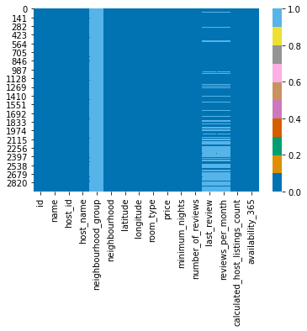
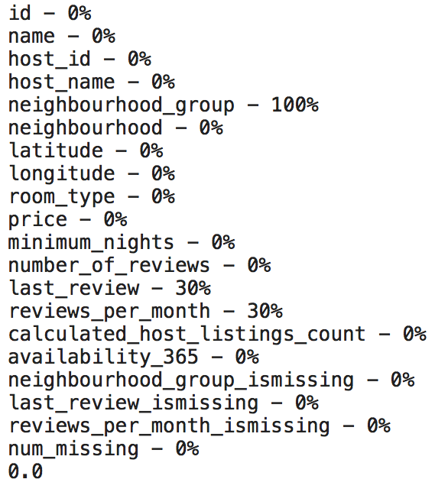
Data Cleaning - before clearing

Slide 6
Data Cleaning
Three columns have missing values
neighbourhood_group
last_review
reviews_per_month
Steps to clean missing values:
Drop the column neighbourhood_group
Replace the missing values in last_review column with '_MISSING_'
Replace the missing values in reviews_per_month with median
Notes:
We drop the column neighbourhood_group because there is no value in the column and we do not think it is important, so it is okay to drop

Slide 7
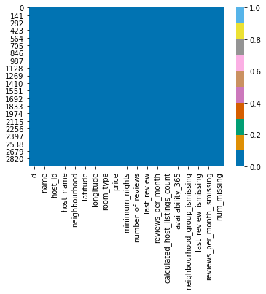
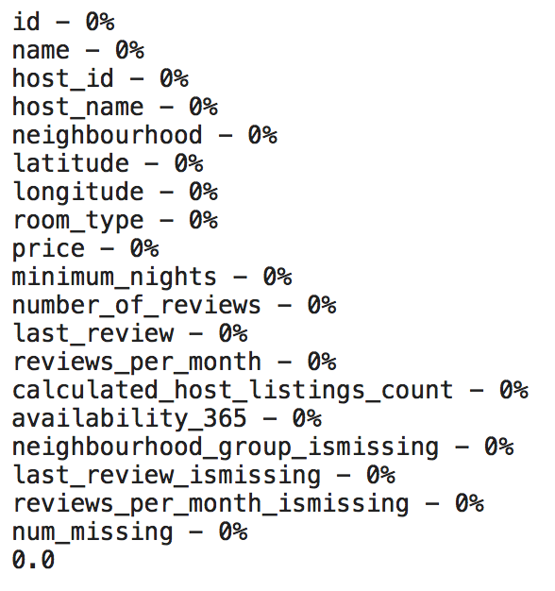
Data Cleaning

Slide 8
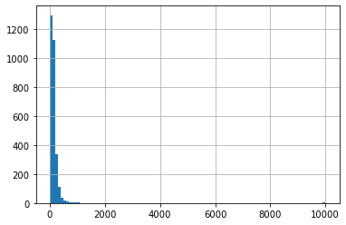
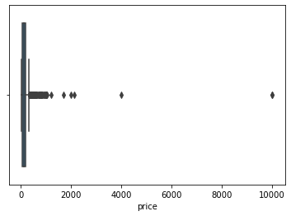
Data Cleaning - Detecting Outliers
Find outliers in outcome variable (price):
count 2955.000000
mean 148.797293
std 295.411137
min 19.000000
25% 70.000000
50% 110.000000
75% 174.000000
max 10000.000000
Name: price, dtype: float64

Slide 9
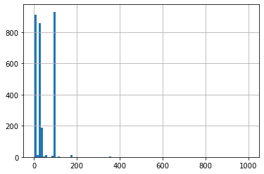
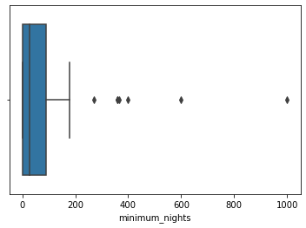
Data Cleaning - Detecting Outliers
Find outliers in control variable (minimum_nights):
count 2955.000000
mean 42.637902
std 44.666107
min 1.000000
25% 2.000000
50% 29.000000
75% 91.000000
max 1000.000000
Name: minimum_nights, dtype: float64

Slide 10
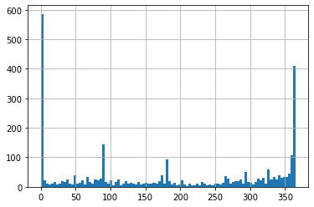
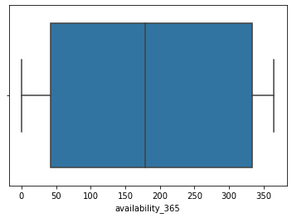
Data Cleaning - Detecting Outliers
Find outliers in control variable (availability_365):
count 2955.000000
mean 183.891709
std 140.973808
min 0.000000
25% 41.500000
50% 179.000000
75% 334.000000
max 365.000000
Name: availability_365, dtype: float64

Slide 11
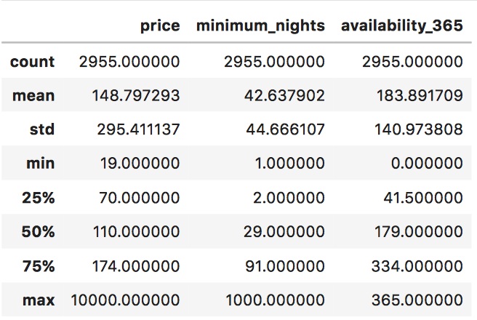
Descriptive Statistics

Slide 12
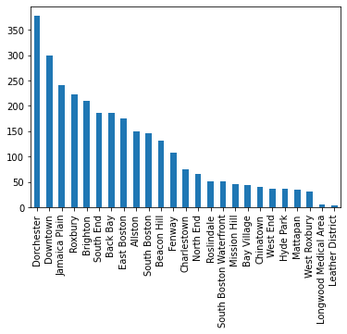
Data Cleaning - Distribution Check
Using a bar chart to see the distribution of a categorical variable neighbourhood
Dorchester has the highest Airbnb in Boston

Slide 13
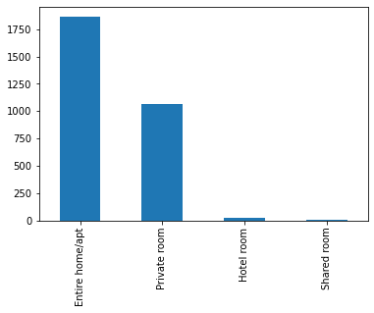
Data Cleaning - Distribution Check
Using a bar chart to see the distribution of a categorical variable room_type
Entire home/apt has the highest availability

Slide 14
Regression

Slide 15
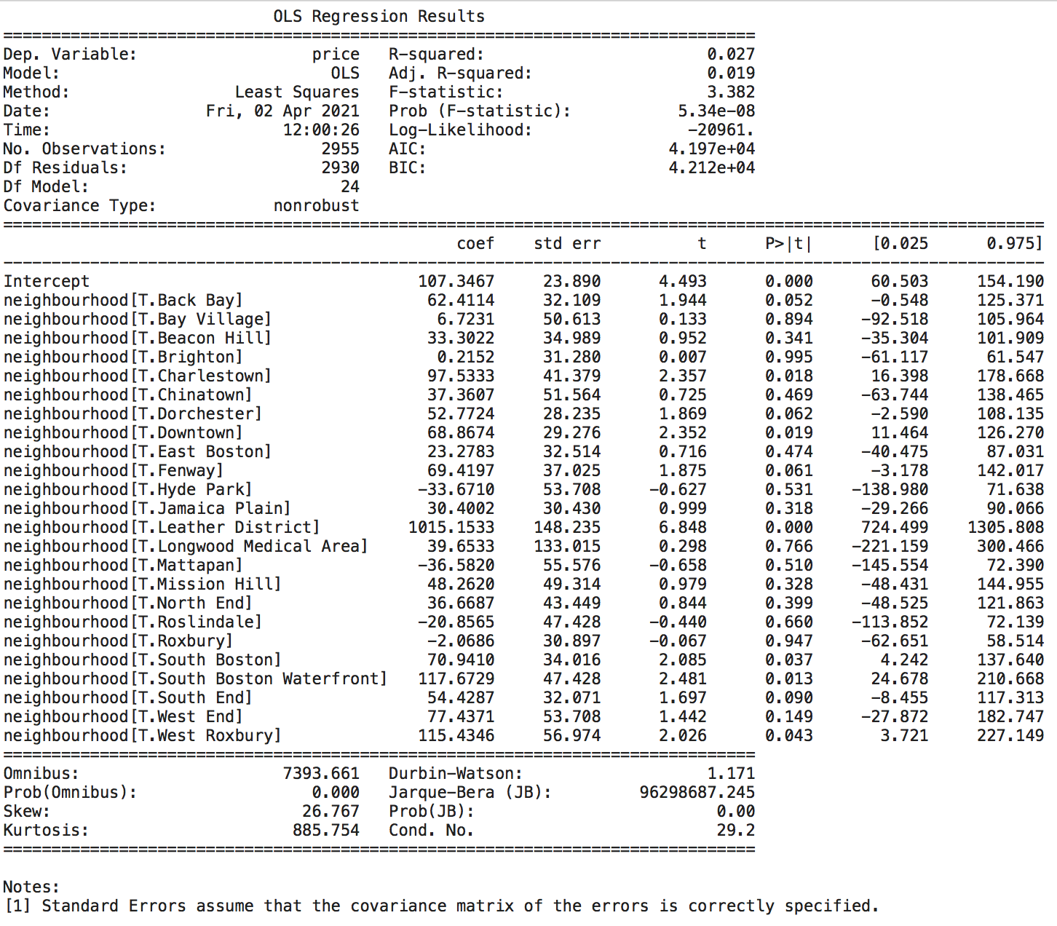
Regression
Model 1:
price = neighborhood
Notes:
First model: price ~ neighborhood
Listings belonging to neighbourhood Leather District had a significant increase in rental price by 1015 unit of dollar, holding other variable constant.
Base variable is Allston

Slide 16
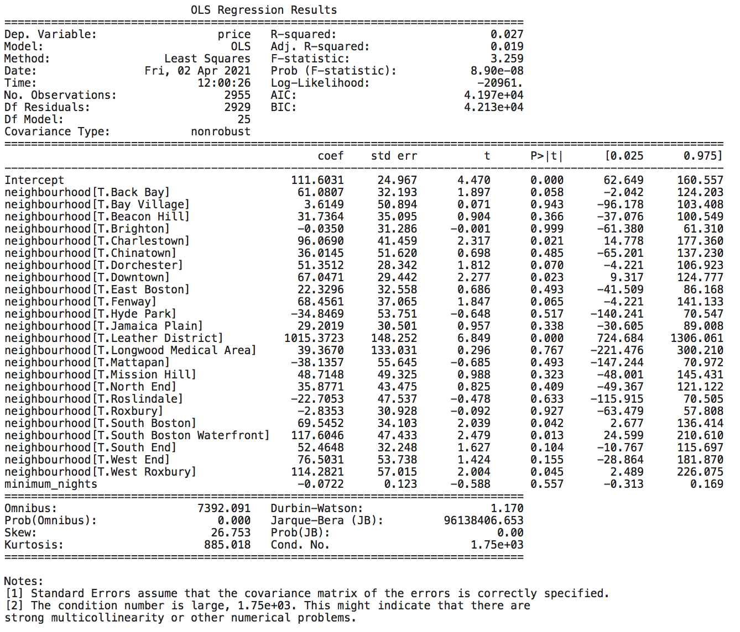
Regression
Model 2: price = neighborhood + minimum_nights
Notes:
An increase in minimum nights by 1 unit will decrease the price of rental by 0.07 dollar.
Based on p-value, this effect is not significant, holding everything else constant.

Slide 17
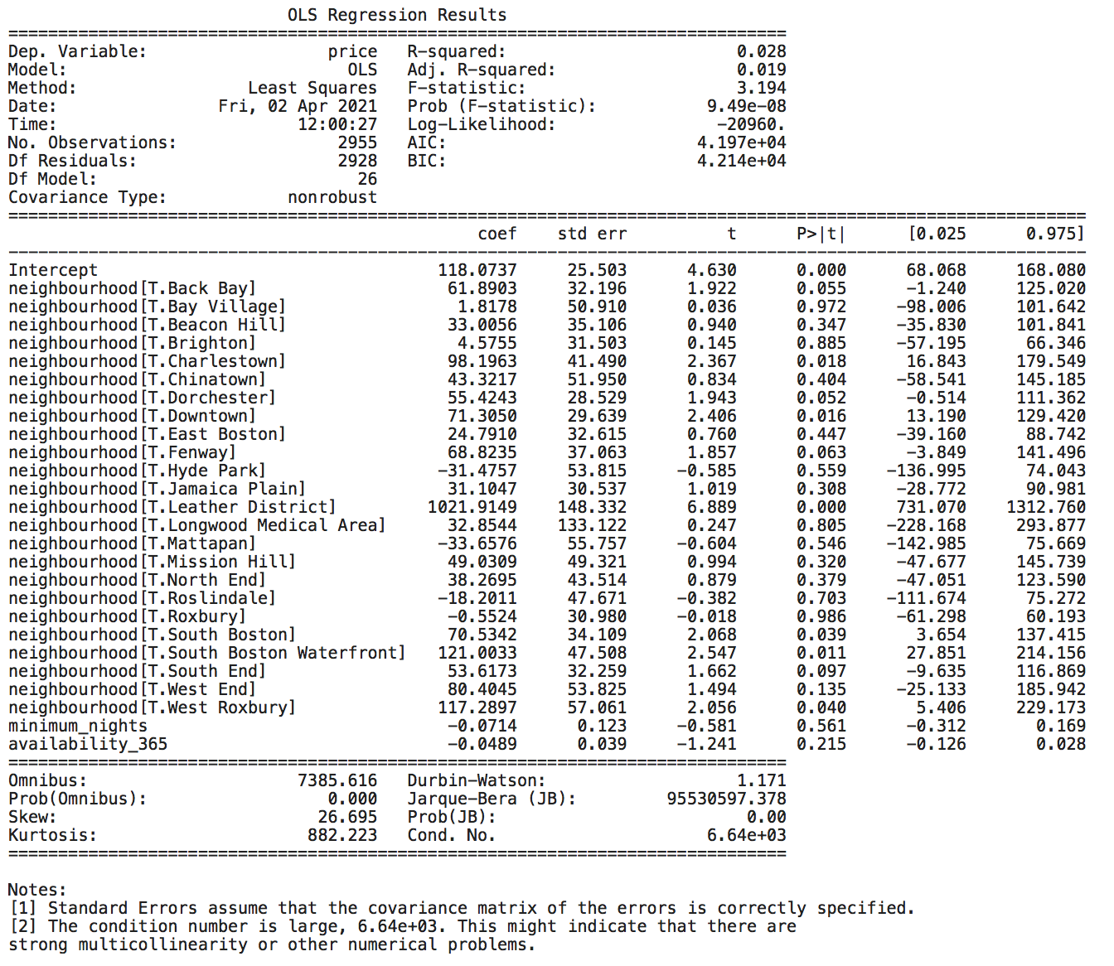
Regression
Model 3:
price = neighborhood + minimum_nights + availability_365
Notes:
An increase in number of listing days by 1 will decrease the price of rental by 0.048 dollar.
Based on p-value, this effect is not very significant, holding everything else constant.

Slide 18
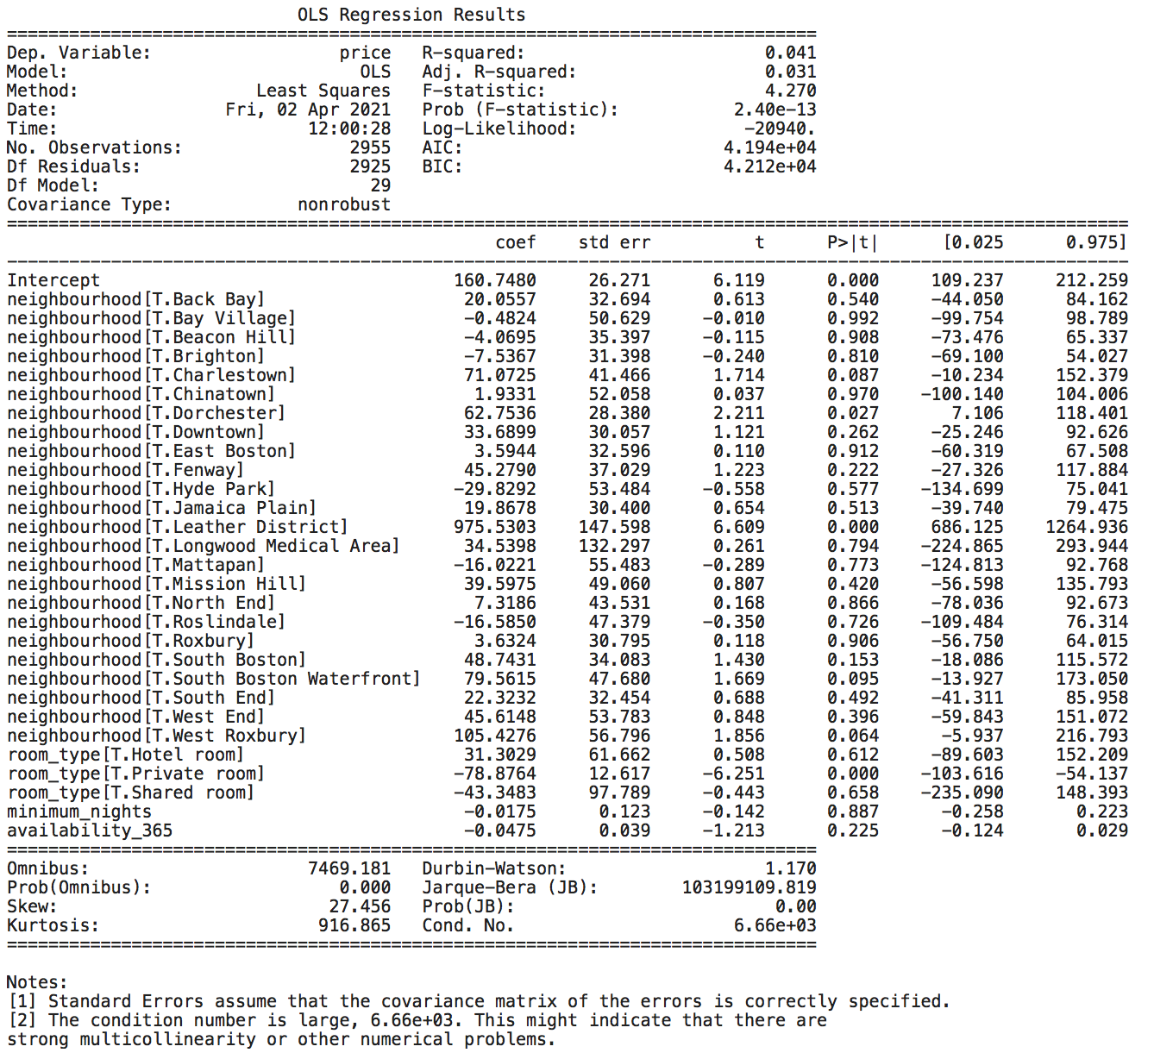
Regression
Model 4:
price = neighborhood + minimum_nights + availability_365 + room_type
Notes:
There is no significant effect to claim that renting a hotel room type or a shared room type will increase or decrease the rental price.
However, renting private room type significantly decrease rental price by 78.88 dollar.

Slide 19
Regression Conclusion
Listings belonging to neighbourhood Leather District had a significant increase in rental price by 976 dollar compared to base variable Allston, holding other variable constant
No significant level of correlation between price and number of minimum nights
No significant level of correlation between price and number of listing day
No significant level of correlation to claim that shared room type of hotel room type with affect rental price
Significant level of correlation to say that renting private room type will decrease rental price by 78.88 dollar
Notes:
After controlling for minimum_nights and availability_365 and room_type, the model still shows significant relation between price and Leather District neighbourhood.
Therefore, we can say that Listings belonging to neighbourhood Leather District had a significant increase in rental price by 976 unit of dollar, holding other variable constant
There is no significant effect to claim that renting a hotel room type or a shared room type will increase or decrease the rental price. However, renting private room type significantly decrease rental price by 78.88 unit of dollar.

Slide 20
Limitation
Not perfect dataset; many non significant coefficients between variables
Missing values
Outliers
No exact time period
No dictionary provided

Slide 21
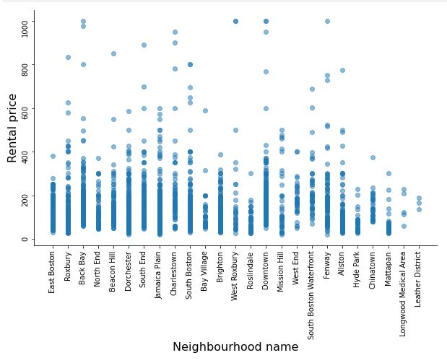
Transforming Data
Scatter plot of price and neighbourhood
Notes:
Showing a scatter plot between outcome variable and explanatory variable. The two dots far away from the rest are the outliers.

Slide 22
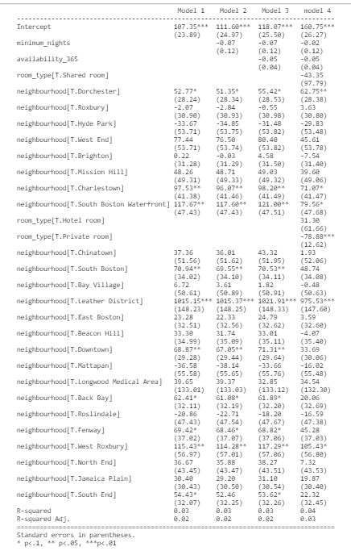
All in one
RQ: Does neighbourhood affect the rental price?
Notes:
This table compare all the regression models together. As we can see here in the table, from model 1 to model 3, there is not much change in coefficients between variables. However, in model 4, we see that those coefficients that are used to be significant are no longer significant.
We see that there neighbourhood Leather District’s coefficient maintains to be significant. Therefore, as 1 additional client rent a place in Leather District, 1015 dollar will also increase. The positive relationship here shows that in client’s perspective, renting in Leather District is more expensive compared to other neighbourhoods.

Slide 23
Suggestions
Leather District should maintain its reputation to attract more rental clients
Other neighbourhoods should start improving their neighbourhoods so that they can also improve their rental price
Rental clients should rent private room type because it cost less rental price compared with other room type
Notes:
In our result shows that some neighbourhoods affect rental price and some do not, so Leather District neighbourhood should maintain its reputation and other neighbourhood should improve their neighbourhood standard so they can have a higher rental price.

Slide 24
Thank You!

